Slide 1
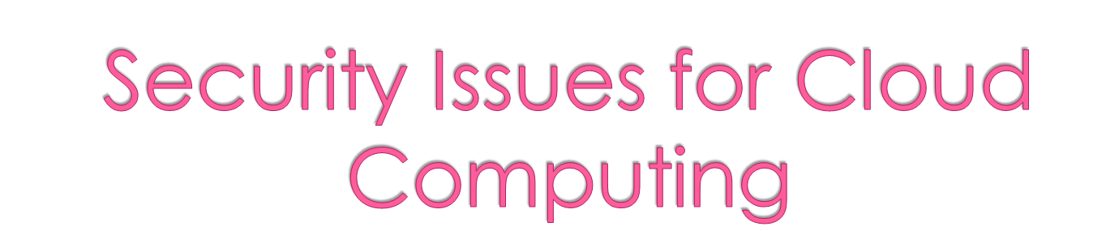
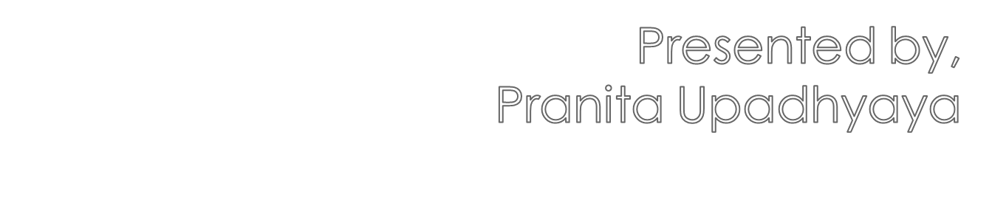

Slide 2
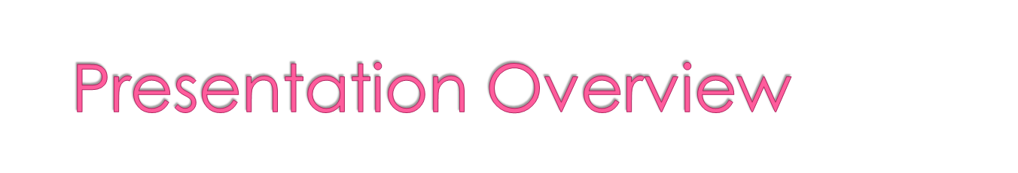
Information Security
Various security counter measures
Importance of security in cloud
Security issues in the cloud
Security Framework

Slide 3

Information security, sometimes shortened to InfoSec, is the practice of defending information from unauthorized access, use, disclosure, disruption, modification, perusal, inspection, recording or destruction

Slide 4
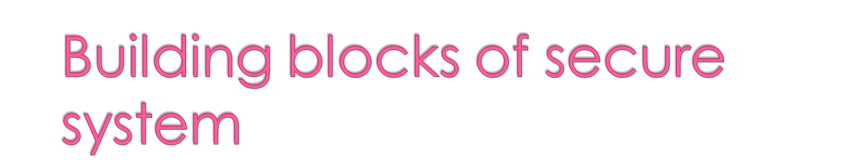
Authentication- to prove one’s identity
Privacy/confidentiality- to ensure that no one can read except the intended receiver
Integrity- The message received by receiver is not altered
Non repudiation- to prove that sender has really sent the message
Availability- system still functions efficiently after some security violations
No single measure can ensure complete security

Slide 5
Various security measures taken so far……

Slide 6
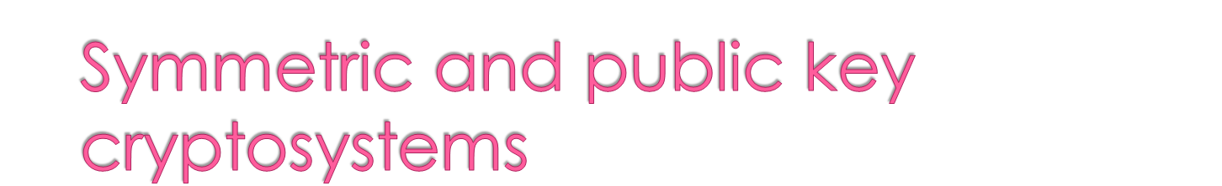
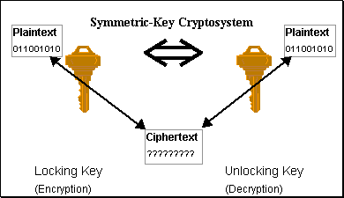
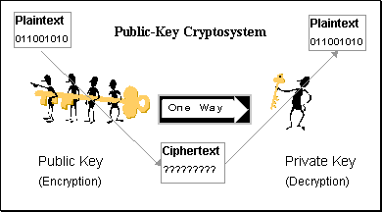
Symmetric-key cryptosystem
same key is used for encryption and decryption
Public-key cryptosystem
separate keys for encryption and decryption

Slide 7
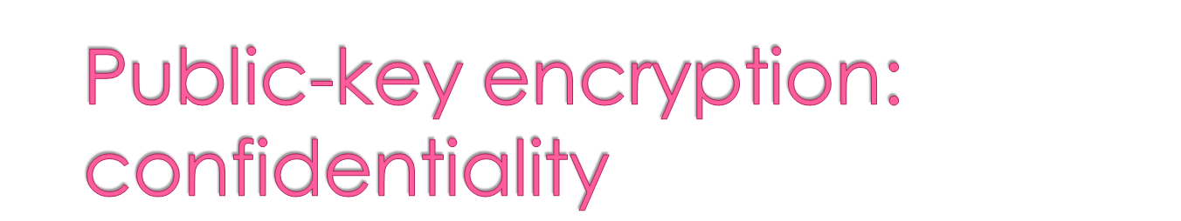
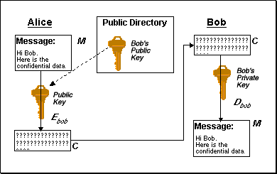
Alice wants to send
message M to Bob
  uses Bob’s public
  key to encrypt M
Bob uses his private
key to decrypt M
  only Bob has key
  no one else can
  decipher M
Identification provided by public key encryption
But … anyone can send message to Bob using his public key
  how are we sure the message came from Alice?

Slide 8
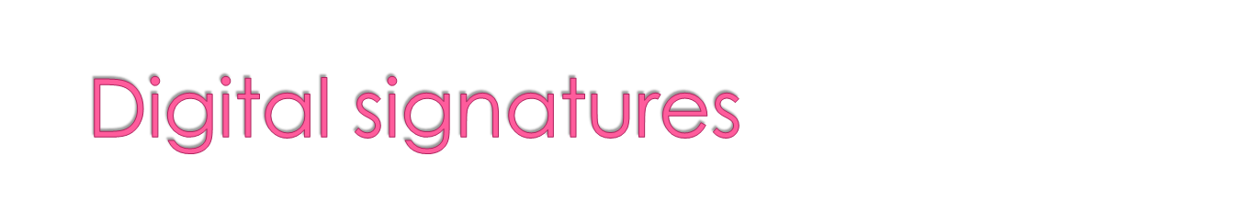
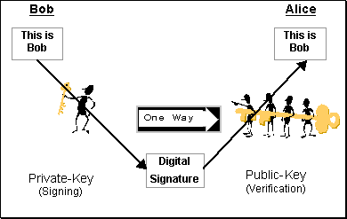
Electronic equivalent of
handwritten signatures
Handwritten signatures
are hard to forge
Electronic information is
easy to duplicate
Digital signatures using
public key encryption
  Idea:
    Bob uses his private key to “sign” a message
    Alice verifies signature using Bob’s public key
Data authentication provided by digital signatures

Slide 9
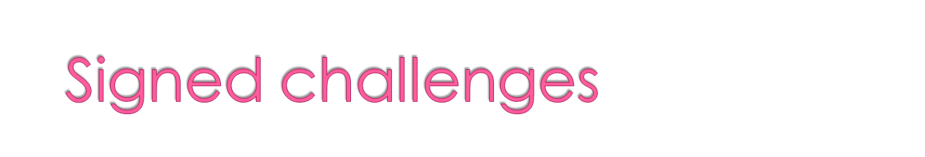
User authentication provided by signed challenges
  Alice and Bob are real or fraud ?

Slide 10
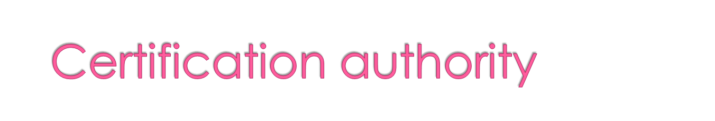
A third party trusted by all users that creates, distributes, revokes, & manages certificates
Certificates bind users to their public keys
Integrity is provided by the certification authority

Slide 11
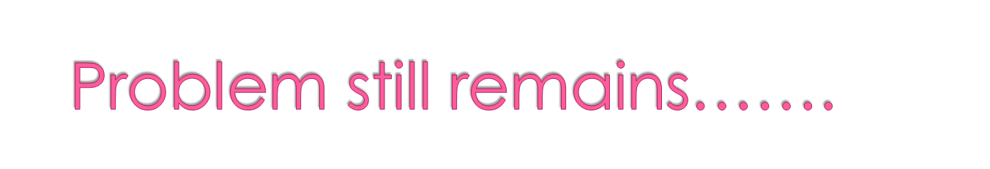
  Problems of ….
  attack on availability:
    disruption or denial of services

Slide 12
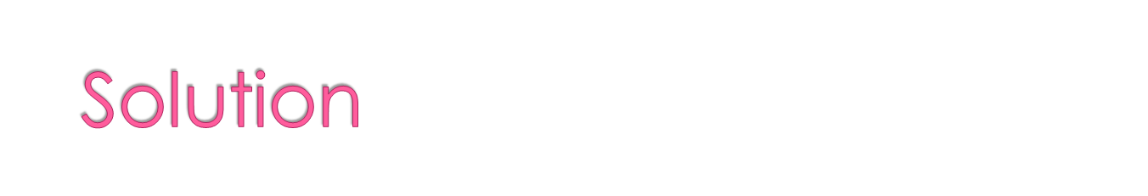
One cannot get stuck with only fault avoidance
Needs to move ahead ….towards fault tolerance
Shall cater dynamic behavior of the intrusion

Slide 13
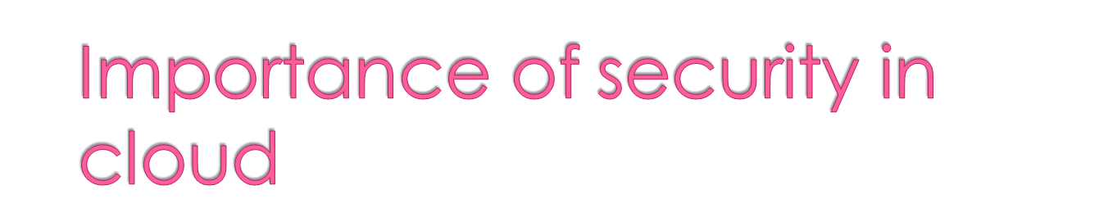
Cloud computing - advantageous for various reasons
However, security threat - a major challenge
Besides regular security measures it needs to cater extra security issues like
  How the services are organized and
  Which kind of service/data can be placed in the cloud?

Slide 14
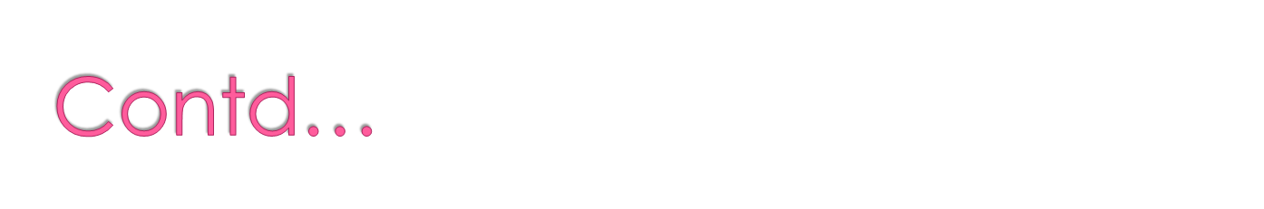
Crucial security and legal obstacles for cloud computing are
  service availability,
  data confidentiality,
  provider lock-in and
  reputation fate sharing

Slide 15
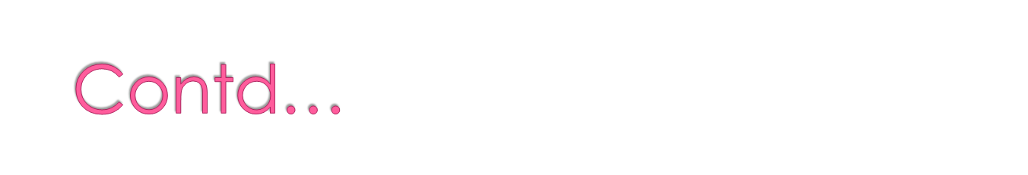
Besides , essential cloud computing features
  scalability,
  resource sharing and
  virtualization needs to be addressed

Slide 16
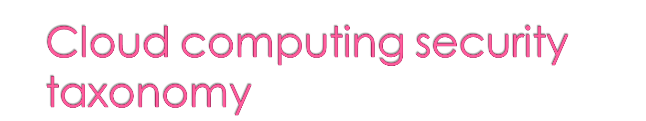
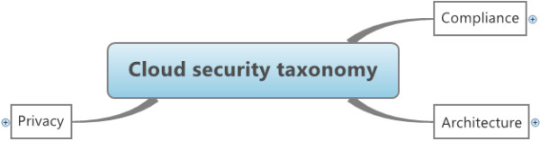
Top level computing taxonomy consists of
  Architecture
  Compliance
  Privacy

Slide 17
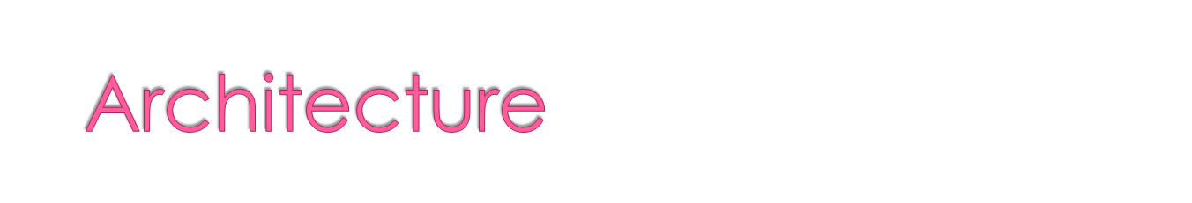
Architecture dimension is further divided into
    Network security
    Interfaces
    virtualization

Slide 18
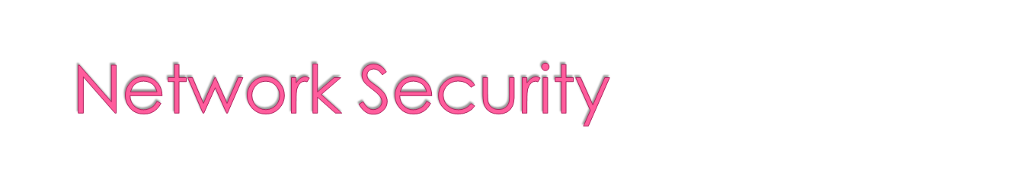
Problems associated with n/w communications & configurations regarding cloud
Offering same or better sets of security than without using cloud in the network

Slide 19
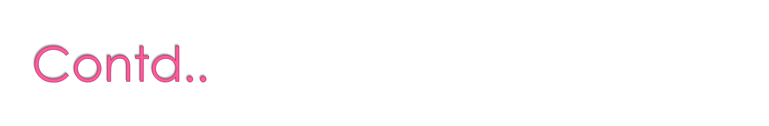
  Transfer security:
    more data in transit in the cloud, thus requiring VPN mechanisms for protecting the system against sniffing, spoofing, man-in-the-middle …
  Firewalling: Firewalls protect the provider’s internal cloud infrastructure against insiders and outsiders
  Security configuration: Configuration of protocols, systems and technologies to provide the required levels of security and privacy without compromising performance or efficiency

Slide 20
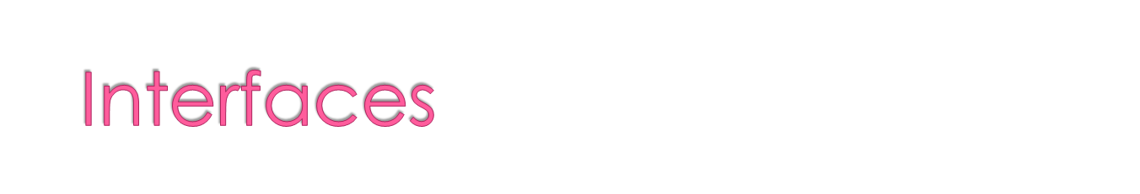
Concentrates all issues related to user, administrative and programming interfaces for using and controlling clouds
  API: Programming interfaces for accessing virtualized resources and systems must be protected
  Administrative interface: Enables remote control of resources in an IaaS ,PaaS and SaaS
  User interface: End-user interface for exploring provided resources and tools
  Authentication: Mechanisms required to enable access to the cloud

Slide 21
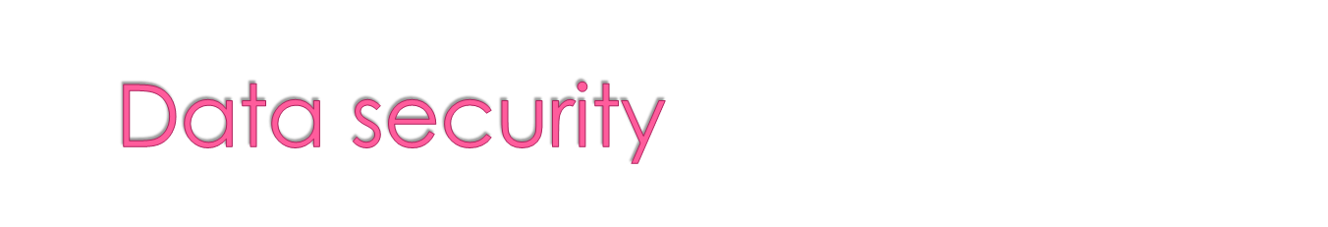
Protection of data in terms of confidentiality, availability and integrity
Cryptography: Most employed practice to secure sensitive data
Redundancy: Repetition, Essential to avoid data loss
Disposal: Complete destruction of data, including log references and hidden backup registries-required

Slide 22
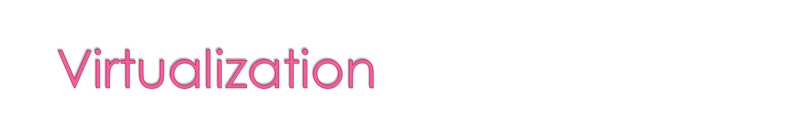
problems associated to the use of virtualization technologies
Isolation : The concept can also be applied to more fine-grained assets, such as computational resources, storage and memory.
Hypervisor vulnerabilities: Hypervisor - main software component of virtualization. Even though there are known security vulnerabilities for hypervisors, solutions are still scarce.

Slide 23
Data leakage: Exploit hypervisor vulnerabilities and lack of isolation controls in order to leak data from virtualized infrastructures.
VM identification: Lack of controls for identifying virtual machines
Cross-VM attacks: Includes attempts to estimate provider traffic rates in order to steal cryptographic keys and increase chances of VM placement attacks

Slide 24
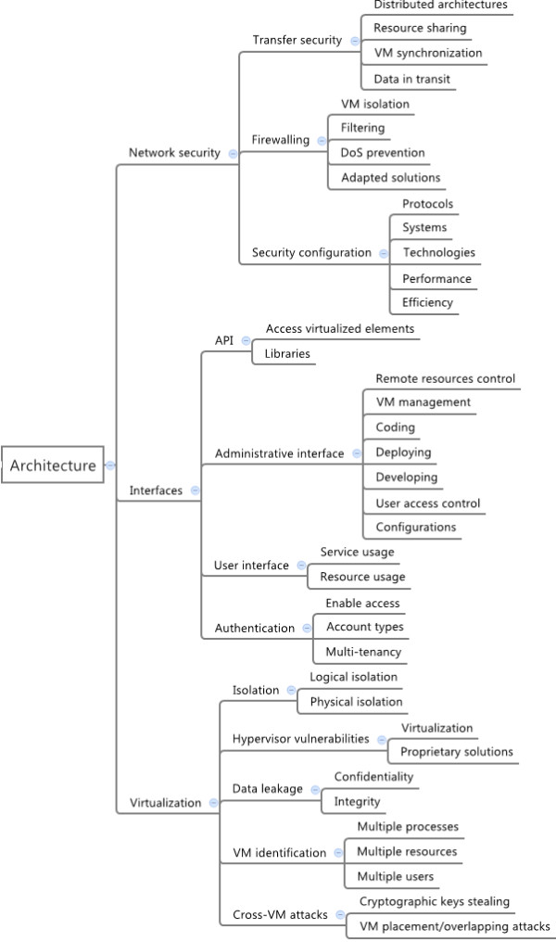

Slide 25
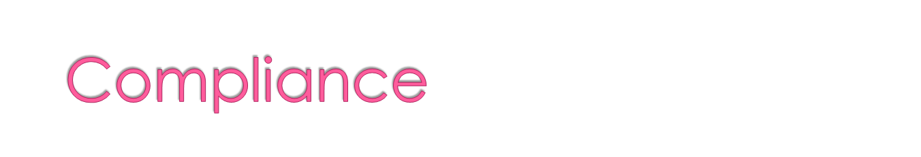
Includes requirements related to service availability & audit capabilities
Service Level Agreements (SLA): Mechanisms to ensure the required service availability and the basic security procedures to be adopted
Loss of service: Service outages

Slide 26

Audit: Allows security and availability assessments to be performed by customers, providers and third-party participants.
Service conformity

Slide 27
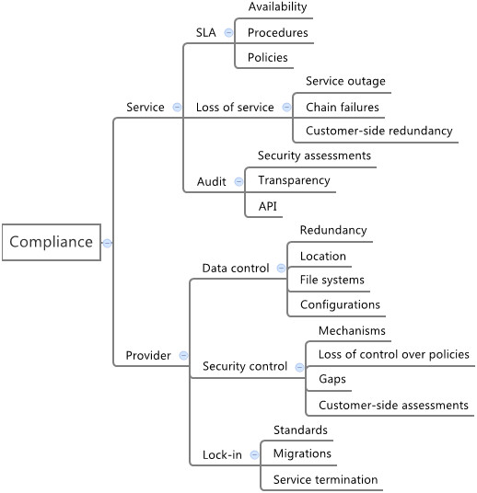

Slide 28
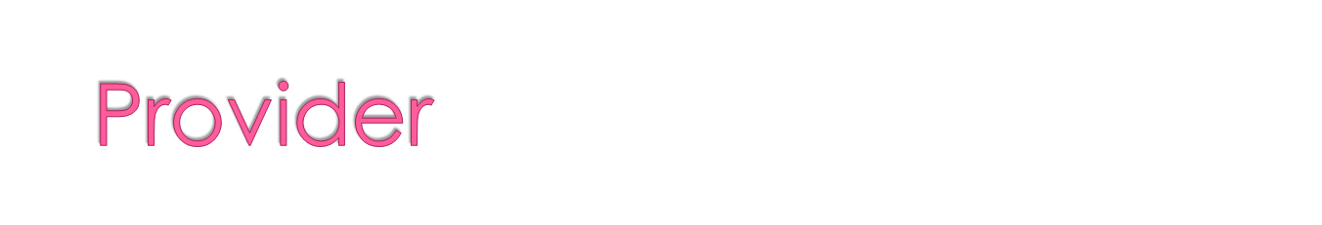
Data control: Moving data to the cloud means losing control over redundancy, location, file systems and other relevant configurations.
Security control: Loss of governance over security mechanisms and policies
Lock-in: User potential dependency on a particular service provider due to lack of well-established standards

Slide 29
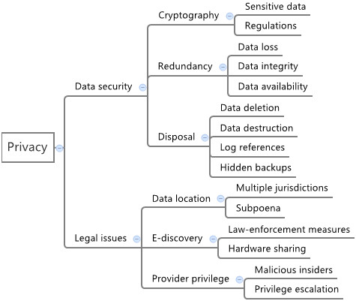

Slide 30
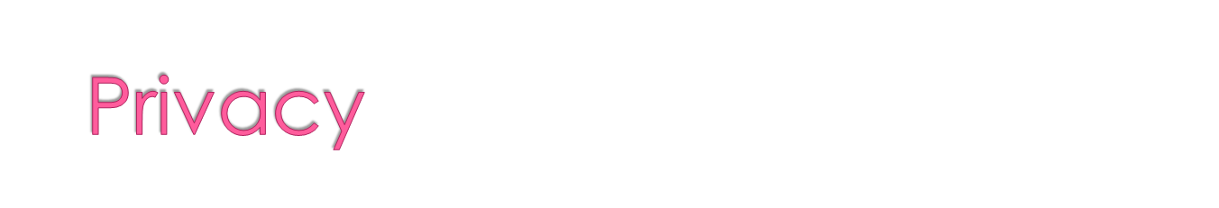
Legal issues: Aspects related to judicial requirements and law
Data location: Customer data held in multiple jurisdictions depending on geographic location are affected, directly or indirectly, by subpoena law-enforcement measures.
E-discovery: As a result of a law-enforcement measures, hardware might be confiscated for investigations related to a particular customer, affecting all customers whose data were stored in the same hardware Data disclosure is critical in this case.

Slide 31
Provider privilege: Malicious activities of provider insiders are potential threats to confidentiality, availability and integrity of customers’ data and processes’ information
legislation: Juridical concerns related to new concepts introduced by cloud computing

Slide 32
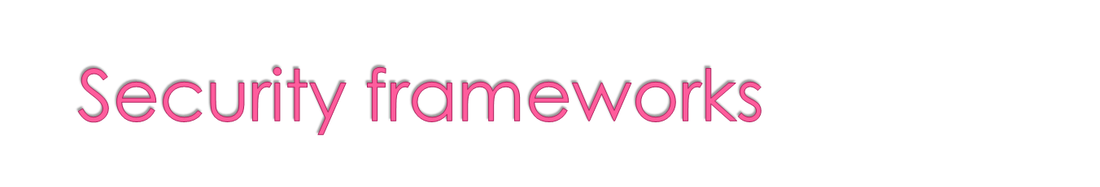
Security frameworks
concentrate information on security and privacy aiming to provide a compilation of risks, vulnerabilities and best practices to avoid or mitigate them
Various popular frameworks are
  ENISA
  CSA
  NISA

Slide 33

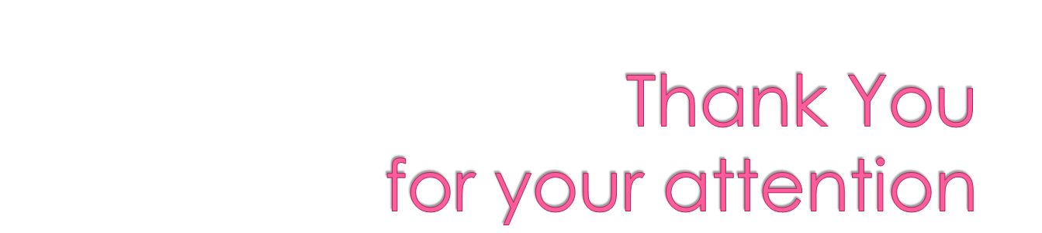

Slide 34


